Slide 1


Slide 2
About today…
Document Object Model
Intro
Tree Structure
Benefits

Slide 3


Slide 4
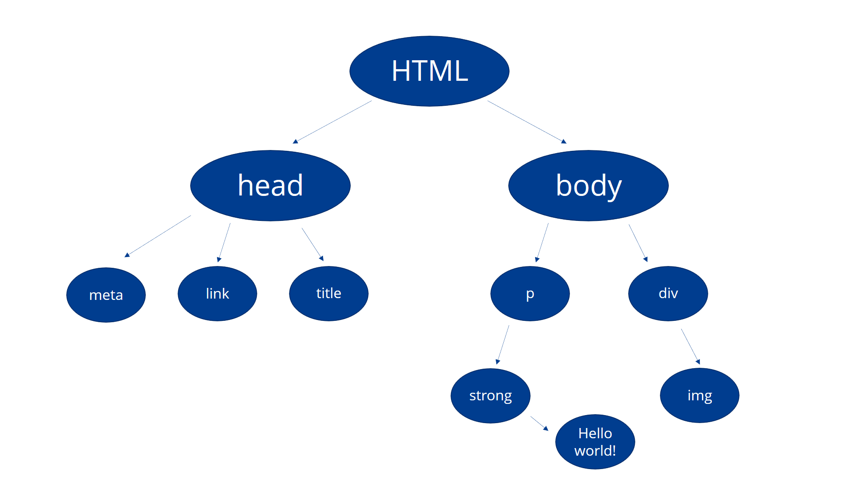
Intro to DOM
Definition
Programming interface that represents the structure of documents as a tree of objects
Allows scripts (like JavaScript) to dynamically access and modify document :
content
structure
style

Slide 5

is DOM Important?
Accessibility
Allows scripts to access and manipulate elements on a webpage, enabling
dynamic content and interactivity
Interactivity
Enables users to interact with web pages, such as clicking buttons, submitting
forms, or updating content without reloading the entire page
Dynamic Updates
Supports real-time updates, animations, and changes to the appearance of
web pages

Slide 6

does DOM work?
Parsing HTML
Browser parses HTML and creates a DOM tree, representing the structure
and content of the webpage
DOM Elements
Each HTML element becomes a node in the DOM tree, forming a hierarchical
structure based on the HTML document's layout
Accessing Elements
JavaScript can access DOM elements using methods like getElementById,
getElementsByClassName, querySelector, etc.

Slide 7
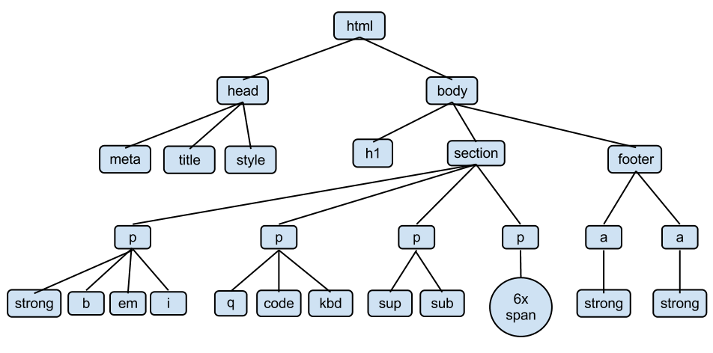
DOM Tree Structure
Elements
Represented as nodes in the DOM tree, with parent-child relationships based on
HTML hierarchy
Attributes
Additional information about elements, such as IDs, classes, and data attributes
Text Nodes
Contain textual content within elements, like paragraphs or headings

Slide 8

Key DOM Concepts
Node
Every element, attribute, and text in the DOM
tree is a node
Parent Node
Element have child node
Child Node
Element have parent node
Traversing
Moving between nodes using methods like parentNode, childNodes, firstChild,
lastChild, etc.

Slide 9
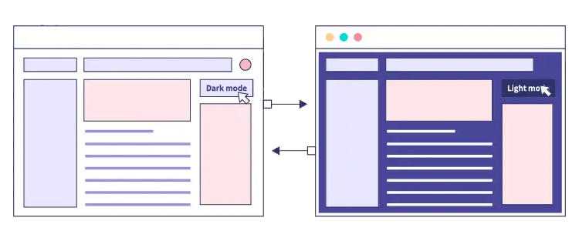
DOM Manipulation Basics
Changing Content
Updating text, attributes, and HTML structure dynamically using JavaScript
Adding/Removing Elements
Creating new elements, appending them to the DOM, or removing existing elements
Style Manipulation
Modifying CSS styles of elements to change appearance or layout

Slide 10
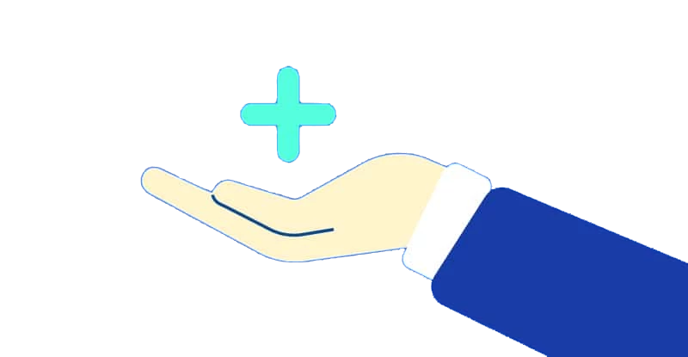
DOM Manipulation Benefits
Responsive User Interfaces
Update content based on user actions, creating dynamic and engaging experiences
Efficient Updates
Modify specific parts of a webpage without reloading the entire page, improving performance
Interactive Forms
Validate form inputs, display feedback, and submit data asynchronously without page refresh

Slide 11


Slide 12

What is the Document Object Model (DOM)?
What are the features of the DOM?
How we can access different DOM elements?

Slide 13

Task 1
Create a simple HTML file and create its DOM tree

